Slide 1
Chapter 3
Lists, Stacks, and Queues
The most simple and basic date structures.
We will introduce Abstract Data Types (ADT).
Show how to operate efficiently on lists
Provide our own implementation of vector and list
Introduce the stack ADT and its use in implementing recursion
Introduce queue ADT and its use in operating systems design
 | CECS 302. Instructor: I Imam

Slide 2
Abstract Data Types (ADTs)
An Abstract Data Type (ADT) is a set of objects with a set of operations.
For an a ADT we may have operations such as add, remove, size, contains, ..., etc.
The implementations of these operations are usually hidden for the user of these types.
The operations provided depend solely on problem requirement and the programmer’s design.
It is recommended that you become familiar with
http://www.cplusplus.com/
Oct 3, 2011 | CECS 302. Instructor: I Imam

Slide 3
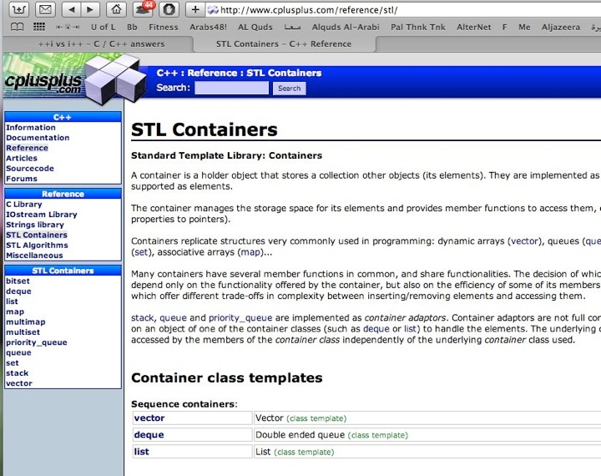
Standard Template Library
Oct 3, 2011 | CECS 302. Instructor: I Imam

Slide 4
The List ADT
Our list is a general list of items
A0, A1, ..., An-1
The size of the list is n and if the size is 0 then the list is empty
We say Ai follows Ai-1 (i < n) and Ai-1 precedes Ai for ( i > 0)
A0 is the first element and An-1 is the last element
The position of the element Ai in the list is i
The set of operations that we would like to define include:
printList, makeEmpty
insert/remove an object A at/from a given position i
find an object A (the position of first occurrence of A) and find the k^{th} object which we call findkth
other candidates may be next and previous
Oct 3, 2011 | CECS 302. Instructor: I Imam

Slide 5
Array Implementation of Lists
An Array implementation of lists means that:
printList will be O(n), i.e. linear time
Find the kth object (findkth) is constant time
insert/remove an object A at/from a given position i are expensive and worst case scenarios are insert at the front or deleting from the end which are O(n)
We must find a better solution to try to reduce the O(n) for insert/delete operations.
Oct 3, 2011 | CECS 302. Instructor: I Imam

Slide 6
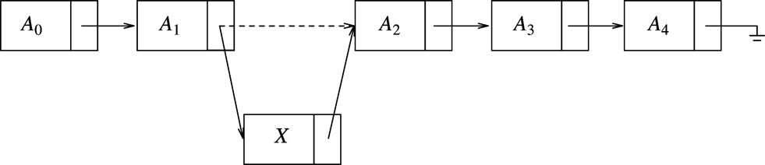
Simple Linked Lists
Entries in a linked list should not necessarily be stored contiguously.
Linked lists are made of nodes where each node contains the element and a link (pointer) to the node containing the successor element.
To printList we start at first node and traverse the list using the links.
For findkth we start at first and traverse list until the k^{th} element.
The insert and delete are done as below.
We need t keep a pointer to first.
Examine how to delete from the end
Oct 3, 2011 | CECS 302. Instructor: I Imam

Slide 7
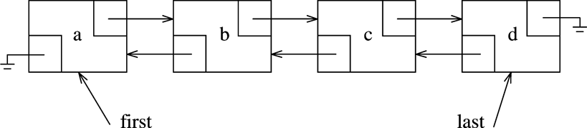
Double Linked Lists
To delete from the end of a linked list we need to keep a pointer to the end, we call it tail.
Once we remove the tail we need to adjust tail to point to the previous node, which we do not know.
To avoid having to trace the list to update tail we keep two pointers in the node one pointing to the successor and one pointing to predecessor
The first node will have no predecessor so that pointer will be null and the tail has no successor so that pointer will be null.
Hence it is the Double Linked List.
Oct 3, 2011 | CECS 302. Instructor: I Imam

Slide 8
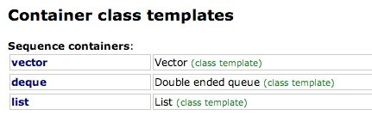
vector and list in STL
STL has two implementations for List ADT.
list is a Double Linked List implementation of List ADT.
vector is a growable implementation of List ADT but has high cost insert and deletion unless done at the tail of list
Both vector and list are class templates that you instantiate with the type of items you want to store
Oct 3, 2011 | CECS 302. Instructor: I Imam

Slide 9
Method for vector and list
Common to all collections
int size() const: returns # of elements in the container
void clear(): removes all elements from the container
bool empty(): returns true if container is empty
vector and list support adding and removing from the end in constant time and accessing the front item in constant time
void push_back(const Object & x): add x to the end
void pop_back(): removes object at end.
const Object & back() const: accessor that return object at end of container
const Object & front() const: accessor that return first object in container
Oct 3, 2011 | CECS 302. Instructor: I Imam

Slide 10
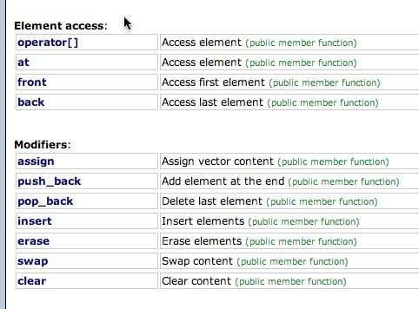
Method for vector and list (cont.)
list only is efficient in changes at the front
void push_front(const Object & x): add x to the front
void pop_front(): remove the object at the front
vector only has
Object & operator[](int idx)
Object & at(int idx)
int capacity() const:
void reserve(int new capacity)
Oct 3, 2011 | CECS 302. Instructor: I Imam

Slide 11
Iterators
Iterator: An iterator is any object that, pointing to some element in a range of elements (such as an array or a container), has the ability to iterate through the elements of that range using a set of operators (at least, the increment (++) and dereference (*) operators).
It is typically a nested class inside other classes such as list or vector
Two important accessors are begin() and end()
Iterators can be compared, incremented and return a reference to the object stored at its value
itr1 == itr2, itr1 != itr2
++itr1 and itr1++
*itr
Methods that require an iterator value are the methods of the container class using the iterator
iterator insert(iterator pos, const Object & x)
iterator erase(iterator pos)
iterator erase(iterator start, iterator end)
Oct 3, 2011 | CECS 302. Instructor: I Imam

Slide 12
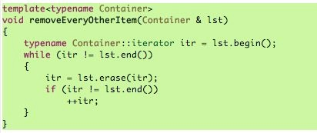
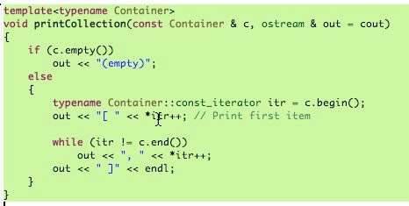
const_iterator vs iterator
const_iterator vs iterator
The advantage of the regular iterator is that you can modify objects through it.
The advantage of the const_iterator is that you can use it to access elements of a container that is const.
Oct 3, 2011 | CECS 302. Instructor: I Imam

Slide 13

Implementation of Vector
The Vector will maintain it’s objects in a primitive array, the array’s capacity and current number of items will also be maintained. Recall primitive array is a pointer to a block of memory allocated with new[] and freed with delete[]
Vector will implement the big three: constructor, destructor, and the copy operator=
Vector will implement resize and reserve
Vector will implement operator[] as both accessor and mutator
Vector will implement basic functionality such as size, empty, clear, back, pop_back, push_back
Vector will use nested types iterator and const_iterator and their begin and end methods
Oct 3, 2011 | CECS 302. Instructor: I Imam

Slide 14
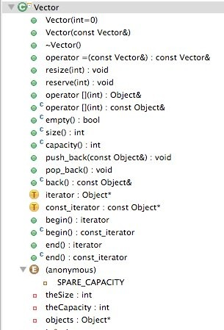
Vector Implementation
Three private variables:
an integer theSize
an integer theCapacity
an Object* objects
Two nested classes
iterator
const_iterator
An enum constant
SPARE_CAPACITY
Two constructors, Destructor, and operator=
Oct 3, 2011 | CECS 302. Instructor: I Imam

Slide 15
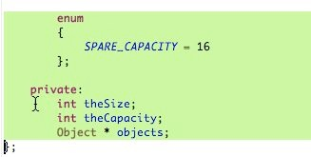
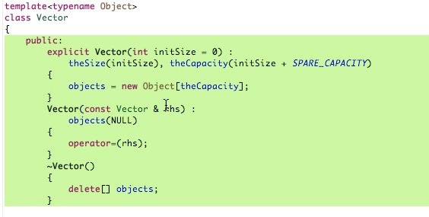
Vector Implementation (cont.)
Oct 3, 2011 | CECS 302. Instructor: I Imam

Slide 16
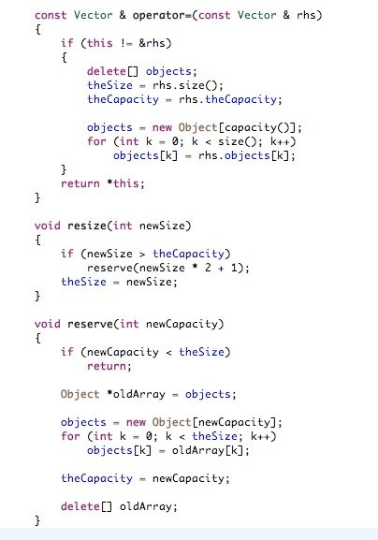
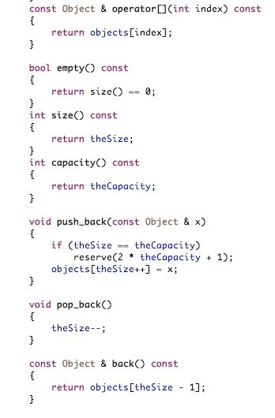
Vector Implementation (cont.)
Oct 3, 2011 | CECS 302. Instructor: I Imam

Slide 17
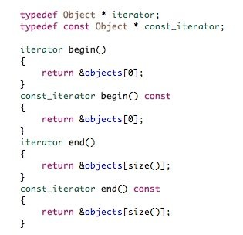
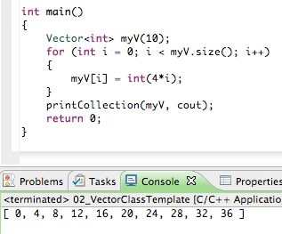
Vector Implementation (cont.)
Oct 3, 2011 | CECS 302. Instructor: I Imam

Slide 18
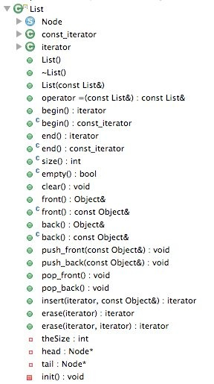
Implementation of List
It has three private variables:
theSize
head
tail
It has a nested Structure called “node”
Two nested classes iterator and const_iterator
It has the big three List(), ~List(), and operator=
Oct 3, 2011 | CECS 302. Instructor: I Imam

Slide 19
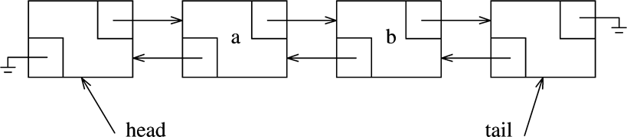
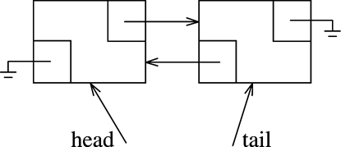
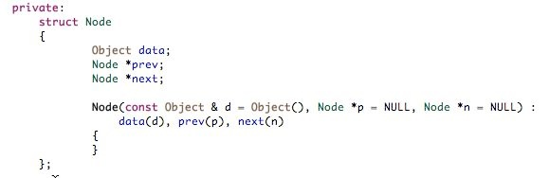
The node Structure
Oct 3, 2011 | CECS 302. Instructor: I Imam

Slide 20
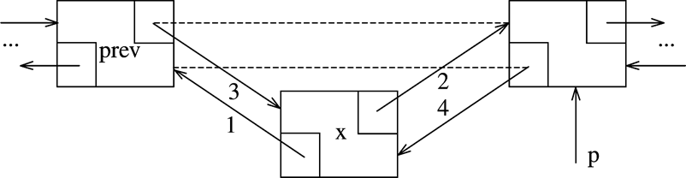
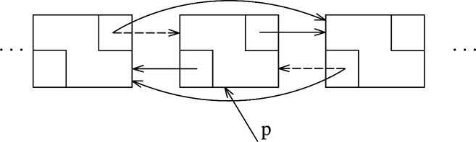
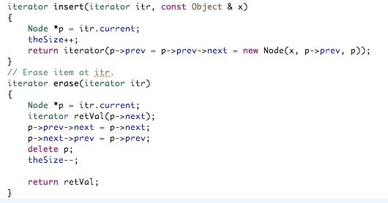
The inserting and removing nodes
Oct 3, 2011 | CECS 302. Instructor: I Imam

Slide 21
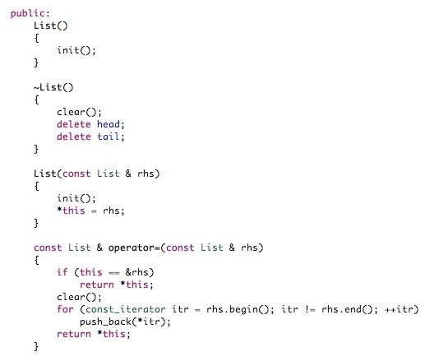
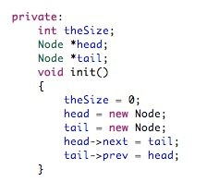
The Big Three
Oct 3, 2011 | CECS 302. Instructor: I Imam

Slide 22
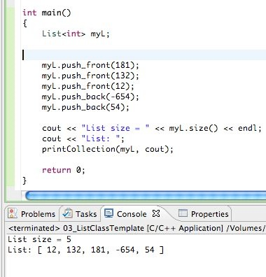
Sample Main
Oct 3, 2011 | CECS 302. Instructor: I Imam

Slide 23
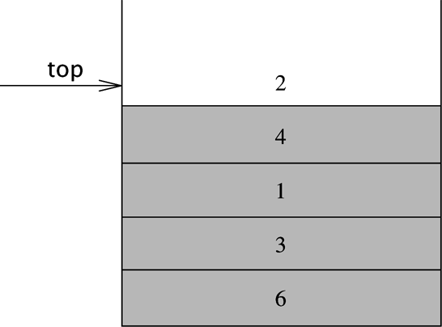
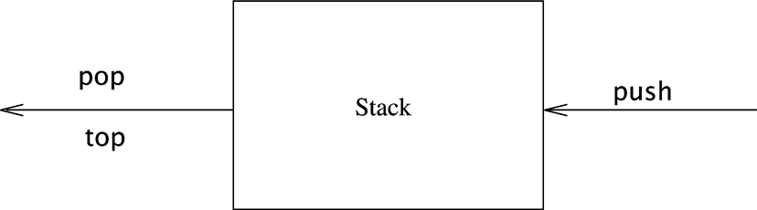
The Stack ADT
A stack is a list with restricted insertions and deletion which can only be performed at the end of list which is normally called top.
It is called a Last In First Out (LIFO) List
The insert operation is called a push and the delete operation is a pop
The pop operation returns the value at the end (top).
You may also use modified vector class to implement a stack, the operations needed are back (top), push_back (push), and pop_back (pop)
Oct 3, 2011 | CECS 302. Instructor: I Imam

Slide 24
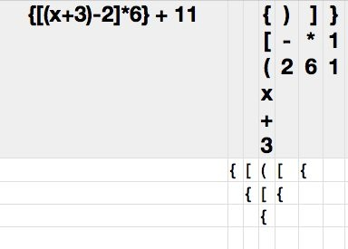
Examples of stack use: Balancing symbols
Opening symbols are { [ (
Closing symbols are ) ] }
All opening symbols are pushed on the stack and all closing symbols are popped from the stack
Rules:
cannot push a closing symbol
the popped symbol must match the closing symbol being read
you cannot have any symbols left on the stack
Oct 3, 2011 | CECS 302. Instructor: I Imam

Slide 25

Examples of stack use: Postfix Expressions
Postfix or reverse Polish notation: In this notation an operator must follow all it’s operands, e.g. to add 3 to 4 mathematically we write 3+4 but in postfix notation the operator + operates on it’s two operands the 3 and the 4, thus we write the expression as 3 4 +
Stacks provide an easy way to evaluate expressions written in postfix notations such as
6 5 2 3 + 8 * + 3 + *
The rules are:
Trace the expression and place all values on the stack
When you encounter an operator pop it’s operands and perform the operation then push the result back on the stack
Oct 3, 2011 | CECS 302. Instructor: I Imam

Slide 26
Examples of stack use: Infix to Postfix Conversion
Since postfix expression can be easily evaluated by using stacks we usually convert expressions written in infix notation (regular algebraic) into postfix notation then evaluate them in a similar fashion to the pervious example.
Consider:
The infix expression: a+b*c+(d*e+f)*g
This is equivalent to: abc*+de*f+g*+
Converting expressions from infix to postfix notations is accomplished by using stacks to keep track of operators and an output buffer to hold the postfix expressions
The rules for stack maintenance are:
the operators order of precedence are (), */, then +-
Operands are immediately placed in the output buffer
Operators that do not have all its operands in the output buffer are saved on the stack
When a new operator is to be placed on the stack all entries on the stack are popped until we reach an operator of lower order
“(“ is popped from the stack only when we encounter “)”
When we reach the end of expression we pop the stack until it is empty
Oct 3, 2011 | CECS 302. Instructor: I Imam

Slide 27
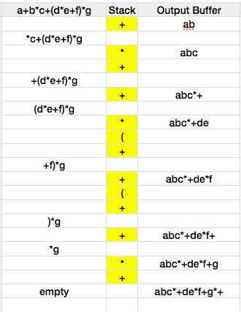
Infix to Postfix Conversion
Oct 3, 2011 | CECS 302. Instructor: I Imam

Slide 28
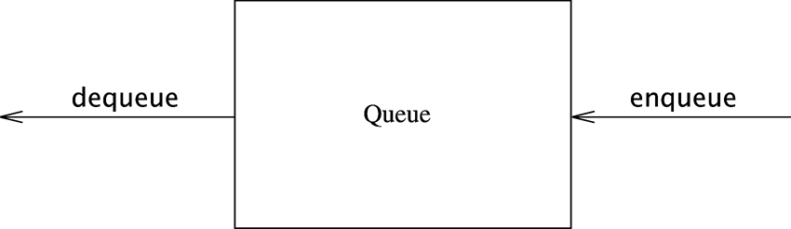
The Queue ADT
The queue is a list where insertion is called enqueue and is done at the end (rear) of the list (end of the queue) and the deletion is called dequeue and is done from the front of the queue.
When you get in line at the cashier in you favorite grocery store you enqueue at the end of the line. When you pay and leave the line you dequeued from the front of the line
You may use lists or arrays to implement queues.
The essential operations needed are enqueue, dequeue, front, back, and currentSize
Oct 3, 2011 | CECS 302. Instructor: I Imam

Slide 29
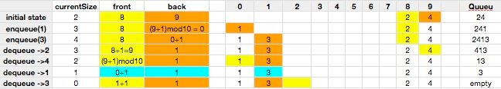
Detailed Operations for Array Implementation of Queues
enqueue x:
currentSize++, back++, theArray[back] = x
dequeue:
the return value must be theArray[front], currentSize--, front++
back++ and front++ are module the array size
Oct 3, 2011 | CECS 302. Instructor: I Imam

